Slide 1
Network design proposal for bank

Slide 2
Abstract
In this project, we will primarily focus on the design and implementation of a Bank Network using Cisco Packet Tracer (CPT). Security breach in the sector of banks is one of the most important concerns that need to be addressed in the first place since loss of information can lead to huge losses to the bank overall. This project will help us curb such concerns by understanding the regulated flow of information/data. We will consider a national bank which has its head offices located in big cities like Chennai. The other small branches will be present in cities like Coimbatore, Madurai, Trichy, Salem, and Thirunelveli. These small branches in each state will be connected through LANs. Apart from this, VLANs and WANs will automatically be a part of the project networking since we are working on a Bank Network. Additionally, bank machines will be made available all around each city in specific to ensure better reach and reliable services to the people. Employees use a special software to access user accounts. The level of access to advanced resources within the bank varies from employee to employee based upon several criteria which include the designation of the employee, criticality of the information etc. The typical servers, mail, web, files and directories will be made available to all the employees to understand the flow of work within the bank.

Slide 3
Team Members
Abhishek S(RA2011033010069)
Lagan Mehta(RA2011033010073)
Sanskar Sharma(RA2011033010079)
Rishu Raj(RA2011033010082)

Slide 4
INTRODUCTION/SCOPE
Designing a Network Proposal for bank
Main office in Chennai
Five branch offices at Coimbatore,Madurai,Trichi,Salem,Thirunelveli
Use of a application Server
High Speed internet connection
200 users in main office
100 users in each branch office

Slide 5
Literature Survey
Networks can also be characterized in terms of spatial distance as local area networks (LANs), metropolitan area networks (MANs), and wide networks (WANs). A given network can also be characterized by the type of data transmission technology in use on it (for example, a TCP/IP or Systems Networks Architecture network); whether it carries voice, data, or both kinds of signals; by who can use the network (public or private); by the usual nature of its connections (dial-up or swathed, dedicated or no switched, or virtual connections); and by the types of physical links (for example, optical fiber, coaxial cable, and Unshielded Twisted Pair).
The flowing methods to be a traditional (old) way of recurrent
Data transfer / transition send branch office to head office by manually.
Need extra cost for transmission because of manually transmission.
Time based transmission
Low security system .Data carries or transfers by human.
User unfriendly because of slow process.
Very complex to maintain.

Slide 6
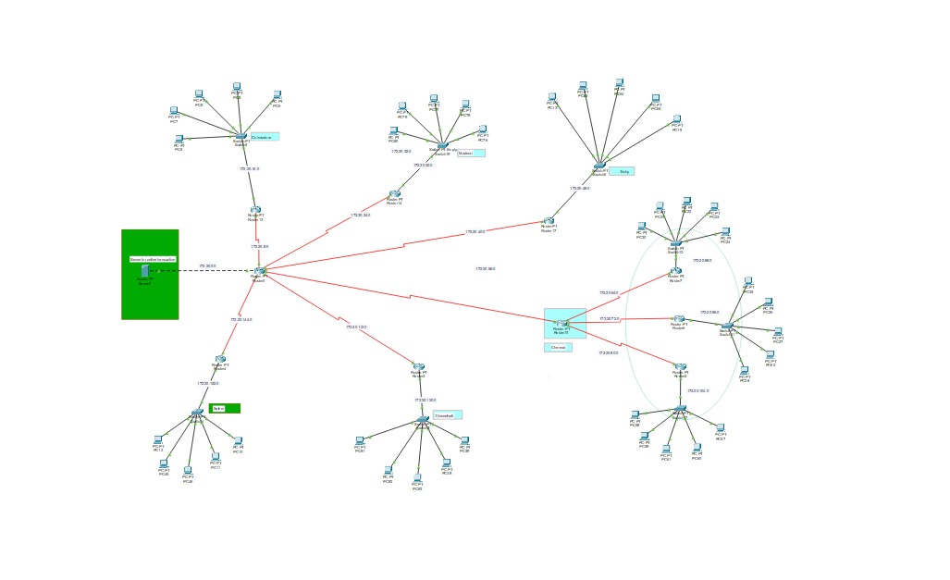
Architecture Design With Modulus Description

Slide 7
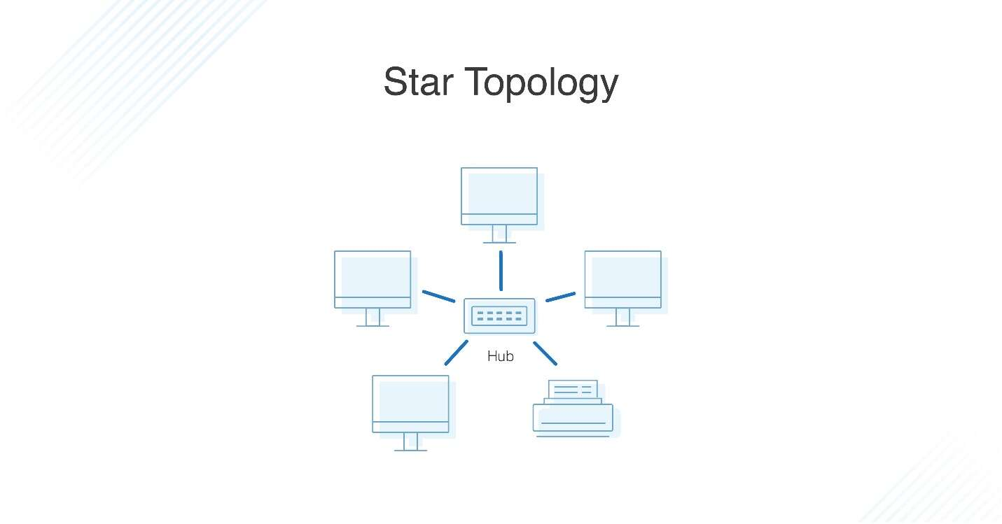
Why Star Network Topology Here
In a star network topology, every host connected to a central node is in its simplest form, one control hub acts as a conduit to transmit messages.
As there is five branch office along with the main branch (Chennai) requirement of a faster network is approx. 100 users in each branch and 200 users in the main office, for this network proposal of the bank, star topology is the most promising network setup here.

Slide 8
VLAN Features and services
VLANs enable logical grouping of end-stations that are physically dispersed on a network.
VLANs reduce the need to have routers deployed on a network to contain broadcast traffic.
Confinement of broadcast domains on a network significantly reduces traffic.
VLANs allow network administrators to automatically limit access to a specified
group of users by dividing workstations into different isolated LAN segments.
When users move their workstations, administrators don't need to reconfigure the
network or change VLAN groups.

Slide 9
Network Requirements:
1. Identify the hardware components required to setup the network for the Bank
2. High availability should be available to the application server, which is accessible using https protocol.
3. The application server should be setup in a secure manner with network and host level protection.
4. All traffic into the application server should be scanned for security attacks.
5. IP network design for the branch and main offices.
6. IP addressing range for users and hardware components.
7. The users at different locations should be able to access each other, including the application server.
8. Identify the features and methodology which would be followed to achieve the solution.
9. Network Topology diagram.

Slide 10
Network requirement analysis
As the locations of the banks are spanned across different geographical locations, a VPN solution is recommended as it would be more economical as compared with a leased line solution. VPN appliances are required for the same. The application server is recommended as Windows 2008 / Windows 2012, with appropriate failover clustering to provide high availability to the application. The application server should be setup on a DMZ, where only access to https protocol (TCP port 443), should be made available to users accessing from the outside. Antivirus with desktop firewall should be installed on the server, which would provide host level protection. An appliance, which would perform deep packet inspection, should be setup on the network, to filter incoming traffic to the application server. This would scan the traffic for security threats and attacks.

Slide 11
Hardware and software requirement analysis
1. At the main office, a VPN appliance would be required, which would have a deep packet inspection. The recommended VPN appliance is Sonic wall NSA 220/W, which has the capacity to support site-to-site VPN tunnels and also has deep packet inspection and firewall capabilities.
2. There are 200 users in the main office. A total of 5 no of 48 port switches are recommended considering ports for servers, VPN appliances, and expansion plans. The Cisco Catalyst 2960S-48FPD-L is recommended for the same.
3. There are 100 users each at the branch office. A total of 3 nos of 48 port switches is recommended, which are Cisco Catalyst 2960S-48FPD-L, considering future expansion plans.
4. Windows 2008/2012 is recommended for the application server with server hardware.

Slide 12
Implementation
For implementing this bank prototype we have used Router-PT which have serial ports, So that it will be easy for us to connect to 6 branches and we have also used 2960-24TT switches all over the network to connect to various campuses among the cities which are then interconnected to the servers and users. All the serial ports are assigned with IP addresses so they can be recognized between the cities without confusion

Slide 13
Cisco Packet Tracer:
Cisco Packet Tracer is a visual simulation tool designed by Cisco Systems that allows users to create network topologies and imitate modern computer networks
Using packet tracer we have implemented network topology, assigned routers and switches.
We can also configure each and every router and network with the IP address and tested whether the data transfer is successful or not.

Slide 14
Result and Conclusion
The network proposal has been finalized for bank as per requirements
Application server and high-speed internet connection has been set up.

Slide 15
References
https://brainbell.com/tutors/A+/Hardware/Basic_Requirements_of_a_Network.htm
https://www.ccexpert.us/network-design-2/characterizing-types-of-traffic-flow-for-newnetwork- applications.html
https://www.netacad.com/courses/packet-tracer

